Slide 1
Introducing Gemini Nano
Matthew Duffield
Summit Software, Inc.
matt.duffield@gmail.com

Slide 2
About Me
Computer Science, Clemson University
Modern Languages, Clemson University
Software Architect
Data Warehouse Architect
Database Administrator
Microsoft MVP
Trainer
Author

Slide 3
Charlotte Radiology – ICD9/10 and CPT classification and prediction (c. 2008)
Microsoft C#
Use of SQL Server Analysis Services
Authoring Naïve Bayes, decision trees, k-cluster algorithms
Use of General Architecture for Text Engineering (GATE)
Use of Human In the Loop for ensuring our systems ”learned”
Strong understanding of statistics

Slide 4
Differences between Non-Generative AI and Generative AI
Non-Generative AI
Highly based on statistics
Ability to retrain or improve real-time
Required traditional training set
Generative AI
Inference based
Takes the language and uses NLP practices to find meaning
Difficult and expensive to retrain/improve models at real-time
Can use Retrieval Augmented Generation (RAG) to improve user experience, which uses Vector embeddings along with NLP
Can use Low-Rank Adaptation (LoRA) to fine tune LLMs by adjusting a small segment
Can use Agents/Chaining for more complex workflows

Slide 5
Why Gemini Nano
Run in browser
No network activity required, after LLM download
Can run in any tab or window
Your data, prompts, conversations, stay on your device
Best architectural approach for scaling
You offset the overhead of expensive servers back to the client
Models are considered, “expert models”
Models are much smaller in size than standard LLMs
This is the future for both devices and desktops

Slide 6
What do I need to use it?
Windows 10, 11
MacOS 13+
At least 22 GB of storage for your Chrome profile
Integrated GPU or separate dedicated video card
Video RAM 4GB

Slide 7
Let’s get Chrome configured…
1. Google Chrome Built-in AI - Early Preview Program -https://docs.google.com/forms/d/e/1FAIpQLSfZXeiwj9KO9jMctffHPym88ln12xNWCrVkMY_u06WfSTulQg/viewform
2. Get Google Chrome Canary or Google Chrome Dev
https://www.google.com/chrome/canary/
https://www.google.com/chrome/dev/
3. Need to ensure that the version is 128.0.6545.0 or greater
4. Open a new tab in Chrome and open: chrome://flags/#optimization-guide-on-device-model
5. Select Enabled BypassPerfRequirement

Slide 8
Let’s get Chrome configured…cont’d
6. Go to chrome://flags/#prompt-api-for-gemini-nano
7. Select Enabled
8. Open DevTools and execute the following in the console:
(await ai.languageModel.capabilities()).available;
9. Confirm the model, Optimization Guide On Device Model with a version of 2024.5.21.1031 or greater

Slide 9
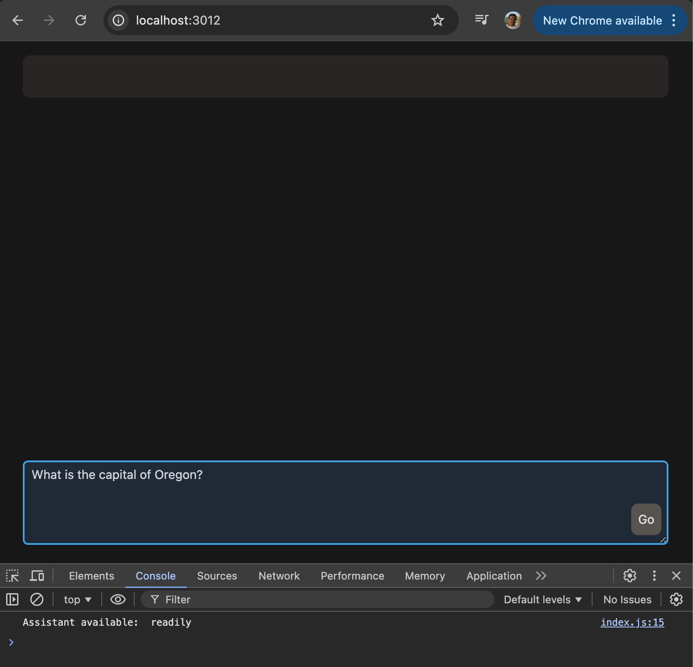
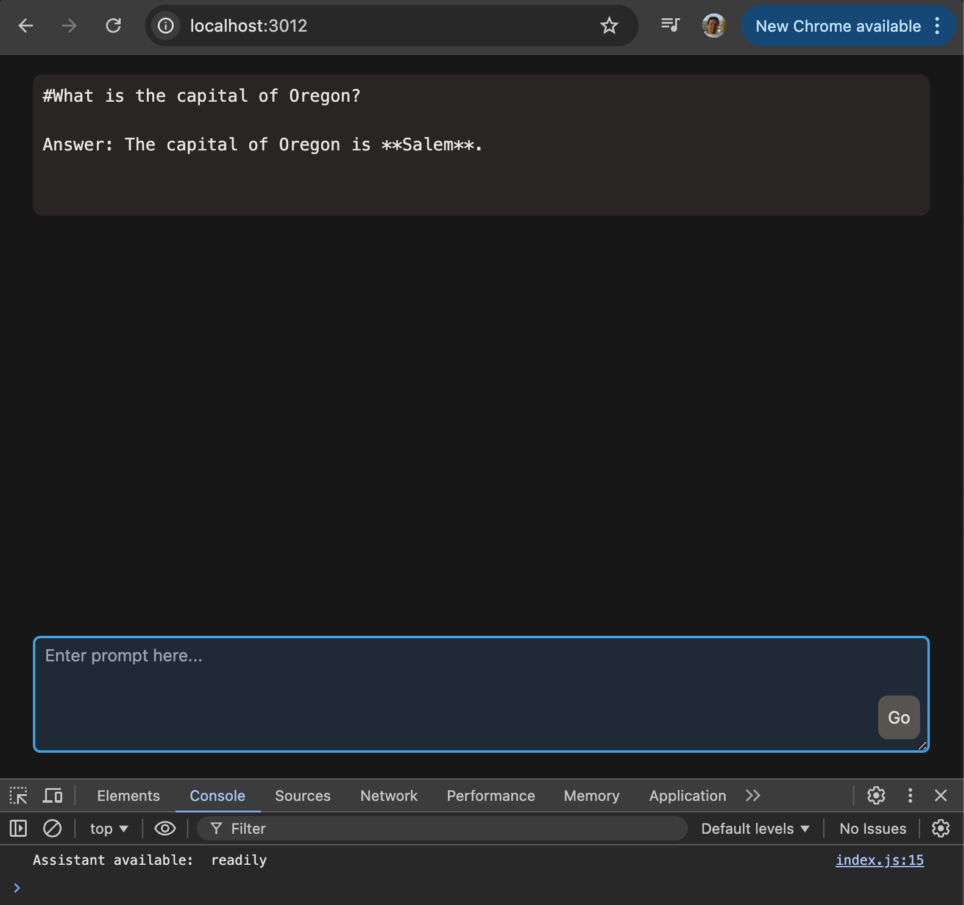
What are we going to build?

Slide 10
Let’s get the source code…
https://github.com/mattduffield/my-assistant
Download the code from the repository
Server Setup
Simple code explanation
index.html
index.js
bundle.css
Sample Prompts

Slide 11
What else can Gemini Nano do already?
Prompt API
Summarization API
Writer API
Rewriter API
Translation API

Slide 12
What’s Next?
Extending what we have learned here and building:
A retrieval augmented generation (RAG) on our own data
Create Vector Embeddings that live in Indexed DB (browser)
Implement natural language processing (NLP) practices to ensure our embeddings are intelligent
Allow users to ask questions based on your embeddings

Slide 13
Resources
https://developer.chrome.com/docs/ai/built-in
https://www.youtube.com/watch?v=VDtgyEB9Q_Q
https://www.youtube.com/watch?v=PJm8WNajZtw
https://deepmind.google/technologies/gemini/nano/

Slide 14
Contact
Matthew Duffield
Summit Software, Inc.
matt.duffield@gmail.com
www.summitsoftwareconsulting.com
www.linkedin.com/in/matt-duffield-6696111
https://www.alignable.com/west-linn-or/summit-software
Please give me a Recommendation if you liked what you saw…

